Slide 1
MGS 351 Final Project
Group 2:
Brendan Wanek
Min Jung Cho
Raluca Popescu
Yash Dhumal
Yeechan Lee

Slide 2
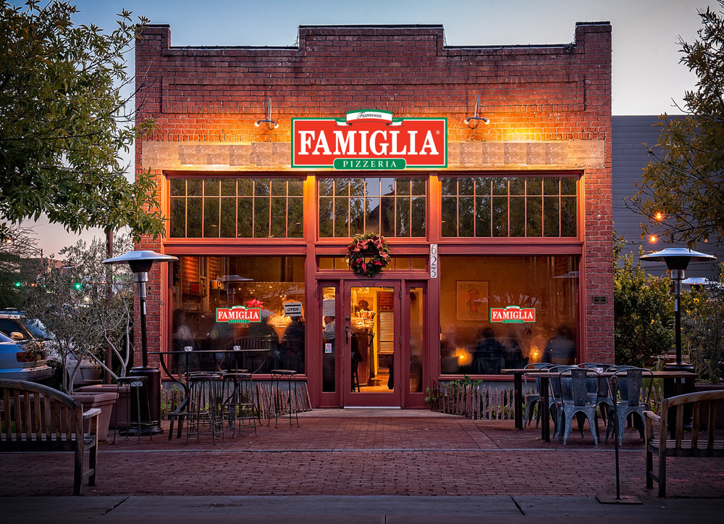
Overview
La Famiglia
Local Pizzeria
Pickup and delivery

Slide 3
Current System
No Computerized System
Pen & Paper

Slide 4
Problems
Easy to loose order
Often have partial data
Lack of Structure
Unorganized and inefficient

Slide 5
Business Value
Keeping track of all business transaction
Increase marketability and profit
More updated and advanced system for the business

Slide 6
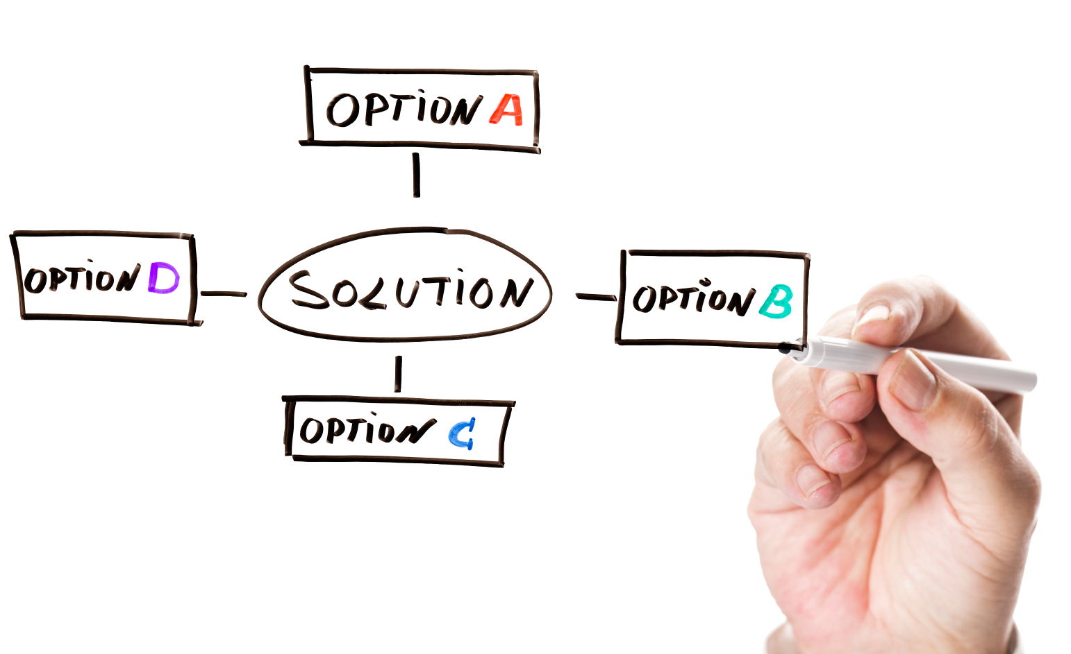
Proposed System & Solutions
Designed a database to combine employees, customers and order data
Making input easy to understand with forms to fill out requiring all necessary data for each category
Improves accuracy and efficiency
Allows for easy retrieval of information and quick look ups

Slide 7
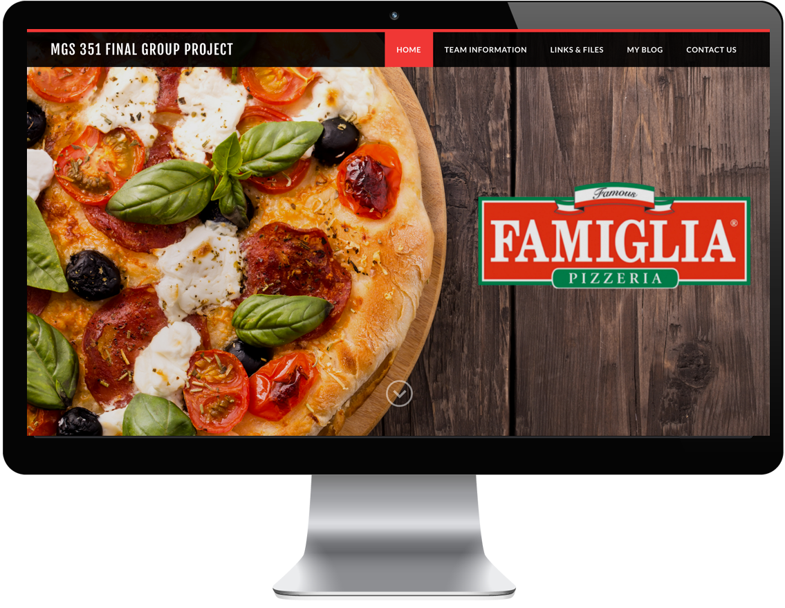
Website

